Slide 1
BoozyAnalytics
A Real-Time Mobile Survey of Alcohol Use and Sexual Consent in Social Research Participants
Samiksha Mailarpwar
Alex Lambrecht

Slide 2
AGENDA
Background and Motivation
Timeline
BoozyMeter
BoozyAnalytics Details
Demo
Technical Architecture
Technical Challenges

Slide 3
Background
Dr. Enbal Shacham (School of Public Health and Social Justice)
Real-time collection of alcohol use and sexual consent
Data Analysis of Reported Data
Mobile App Survey (Android) - Capstone I
Web-Facing Portal for Researcher - Capstone II

Slide 4
Motivation?
Addresses a Public Health issue
Current research relies on old surveying methods
Participants respond days after drinking episodes
Inaccurate data surveying
Goal: report behavioral data in realtime

Slide 5
Timeline
Deliverable 4:
Additional app features
Finished Web portal
Pilot App
May 8
Deliverable 2:
Functioning App
app used for data gathering
August 9
Deliverable 1:
Location
Communication with cloud/server
Time Stamp
UI Sketches
June 30
Deliverable 3:
User-facing layout
web element
App Updates
Excel alpha version
March 2

Slide 6
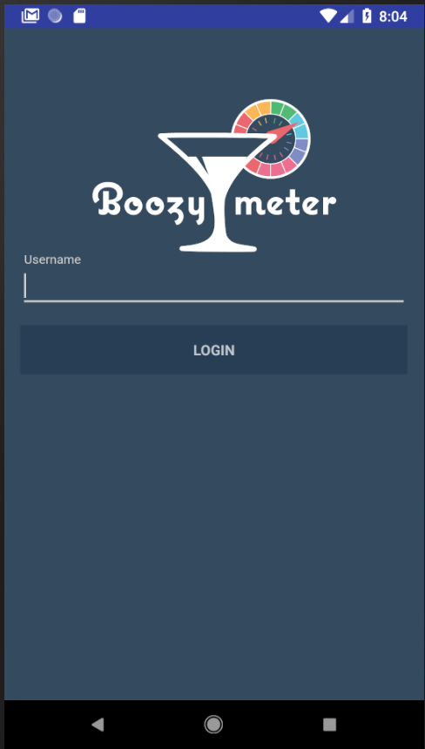
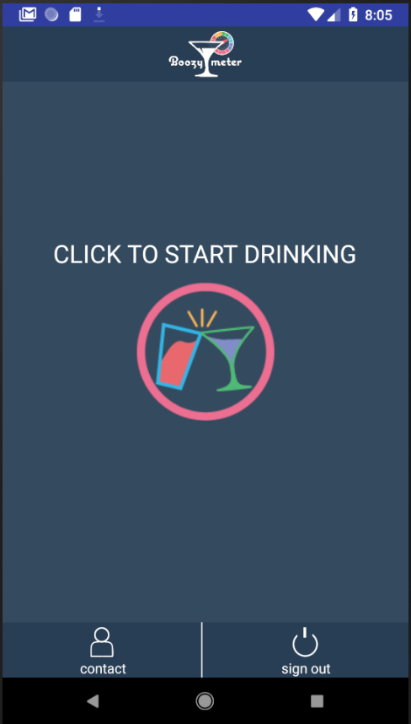
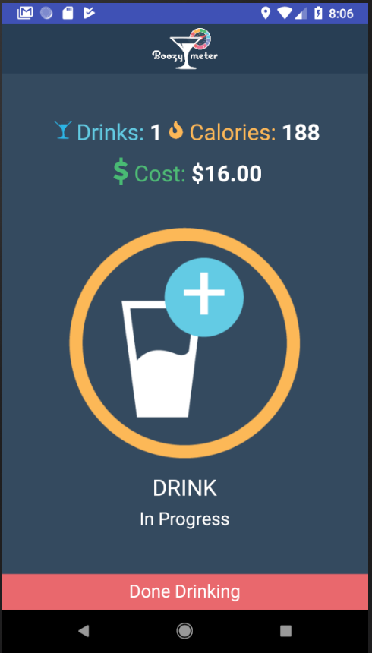
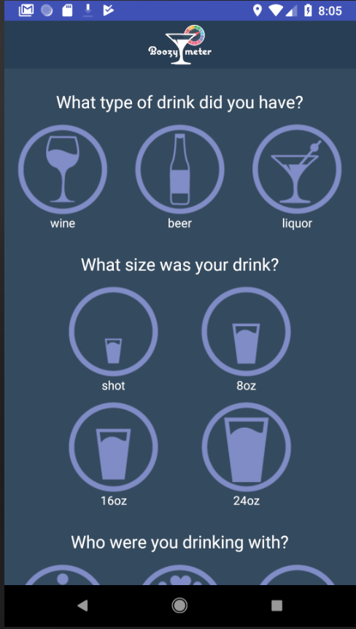
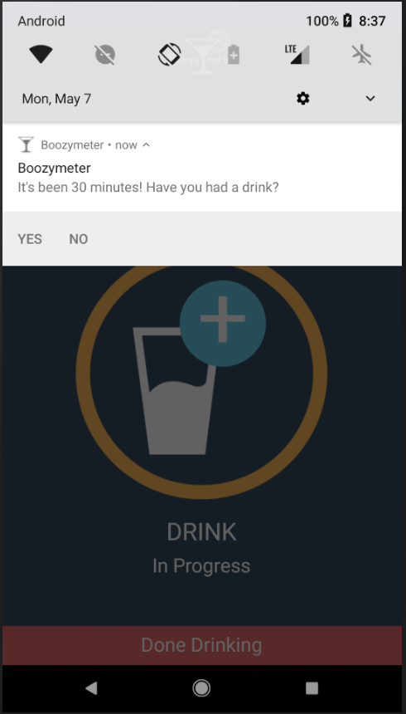
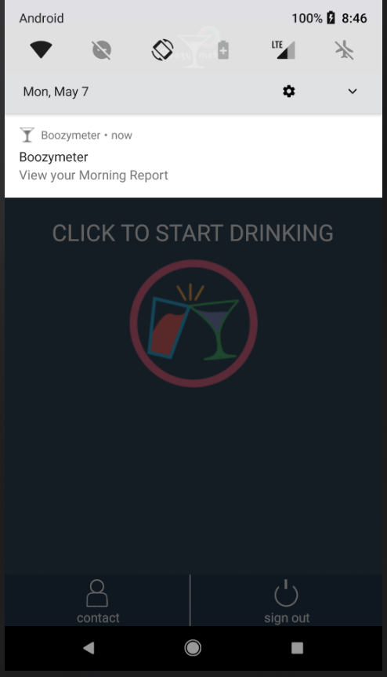
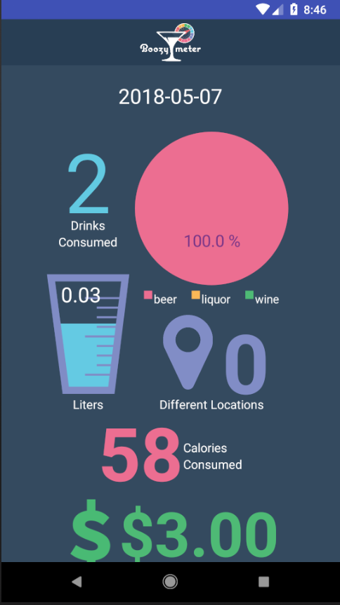
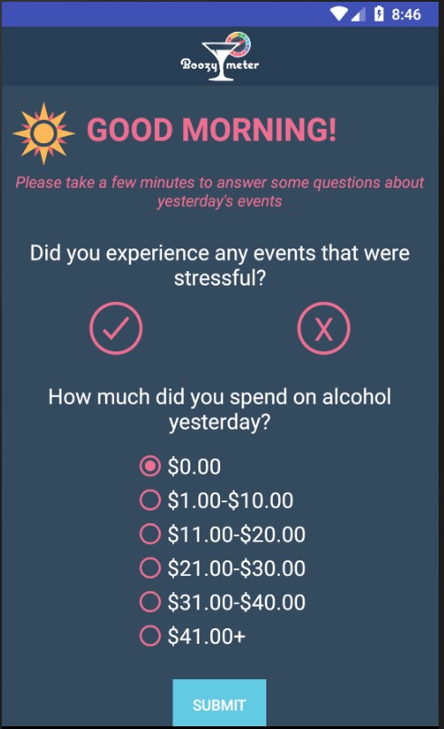
*
*
*
*

Slide 7
BoozyMeter Updates
Control vs. Experimental Groups
During an episode, experimental sees:
# of Drinks Consumed
Calories Consumed
Money Spent
Next morning, experimental sees report of previous night
6 pilot users
Brought forth bugs and UI issues
Made those fixes
Version control for notifications

Slide 8
Basic Features of BoozyAnalytics
Admin portal for BoozyMeter
User management capabilities (add/delete)
Control/Experimental Group Management
Exporting Data
Live Dashboard
Individual Participant Activity Analysis

Slide 9
DEMO

Slide 10

Platform
BoozyMeter: Android (mobile)
AngularJS, HTML, CSS (web)
Database: Google’s Firebase

Slide 11
Technical Challenges

Slide 12
Challenge 1
BoozyMeter first, BoozyAnalytics later
Challenge: Forced to make SW choices made for BoozyMeter work for BoozyAnalytics
Ideal for this project: side by side development

Slide 13
Challenge 2:
Steep learning curve
Angular-Fire requires specific structure
Challenge: no time to plan/research due to time crunch

Slide 14
Further Development
Extend to iOS and wearable technology
More analysis on data
Make more experimental groups

Slide 15
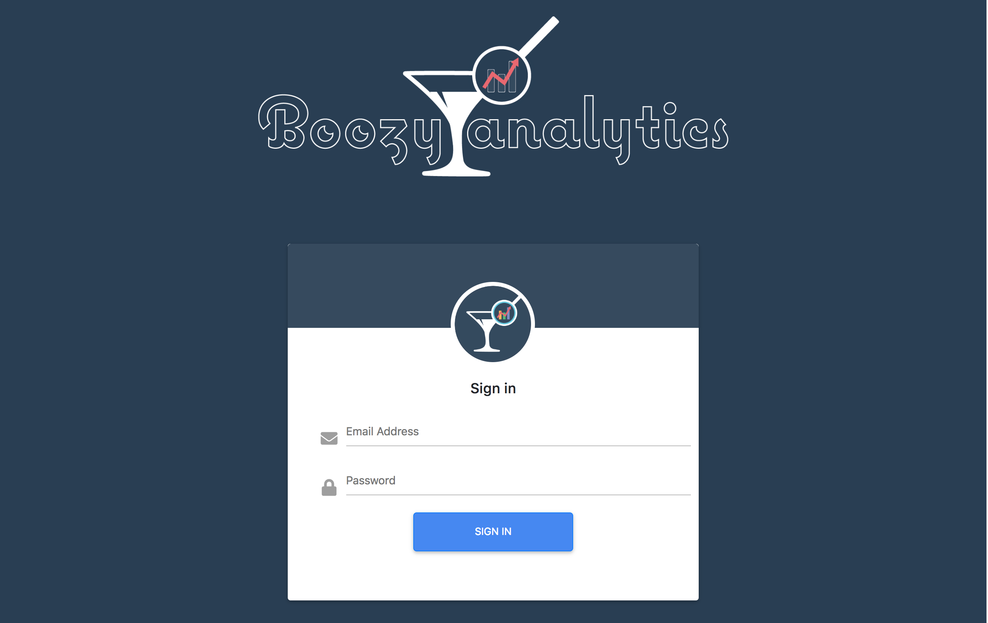

Slide 16
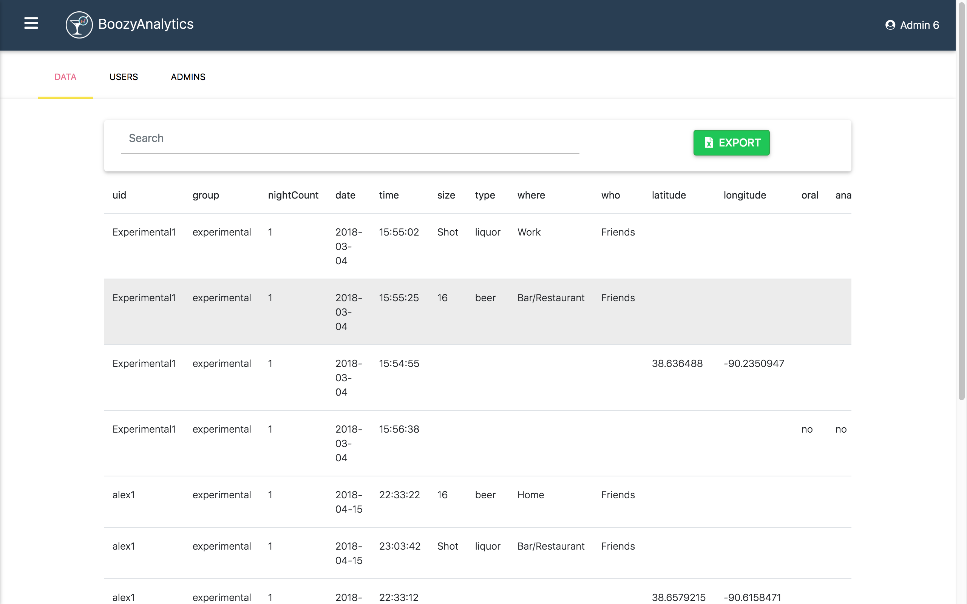

Slide 17
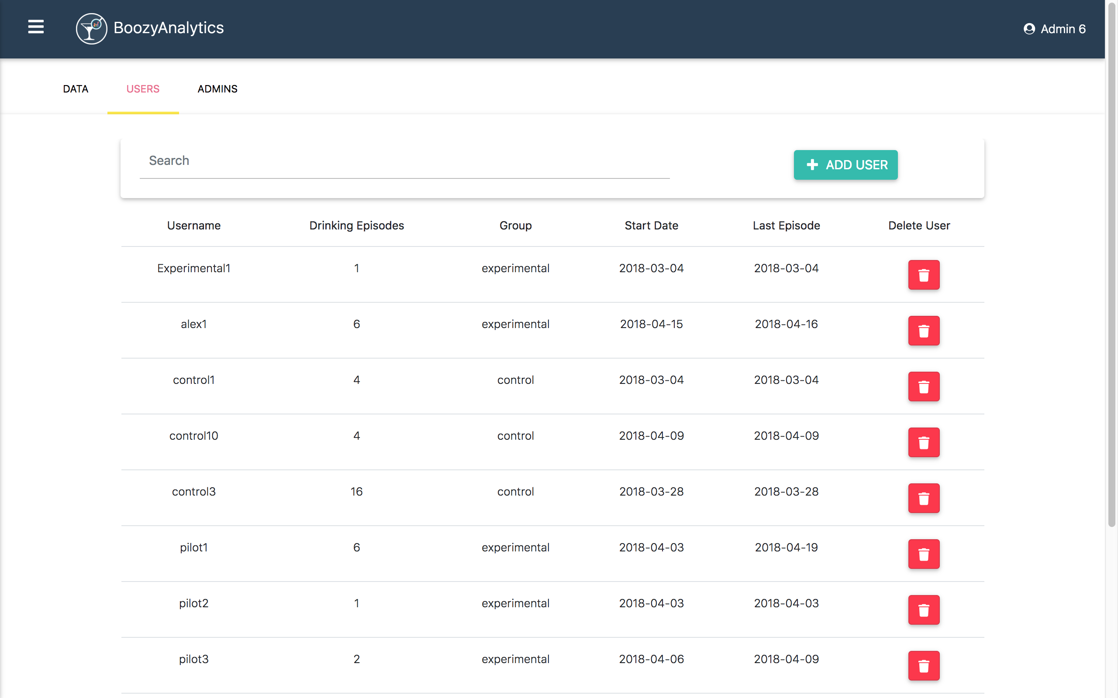

Slide 18
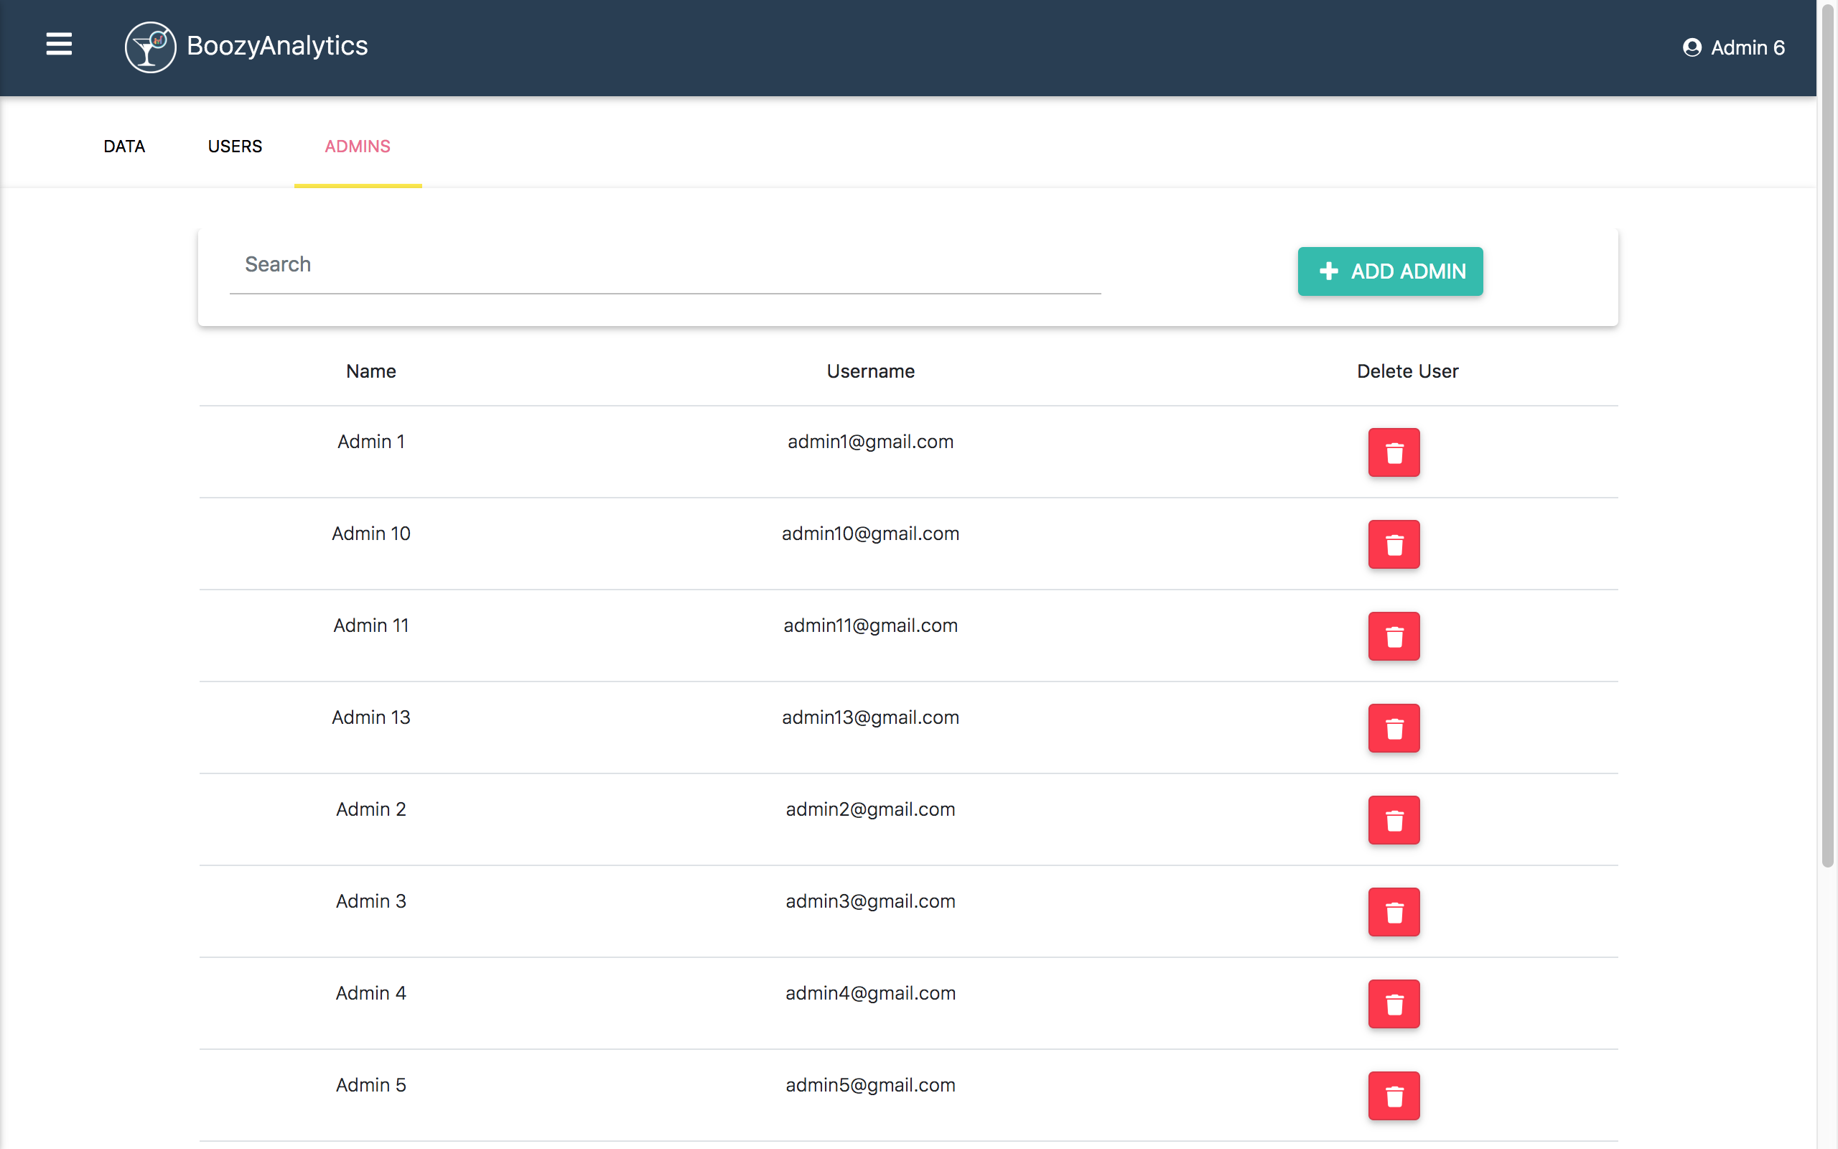

Slide 19
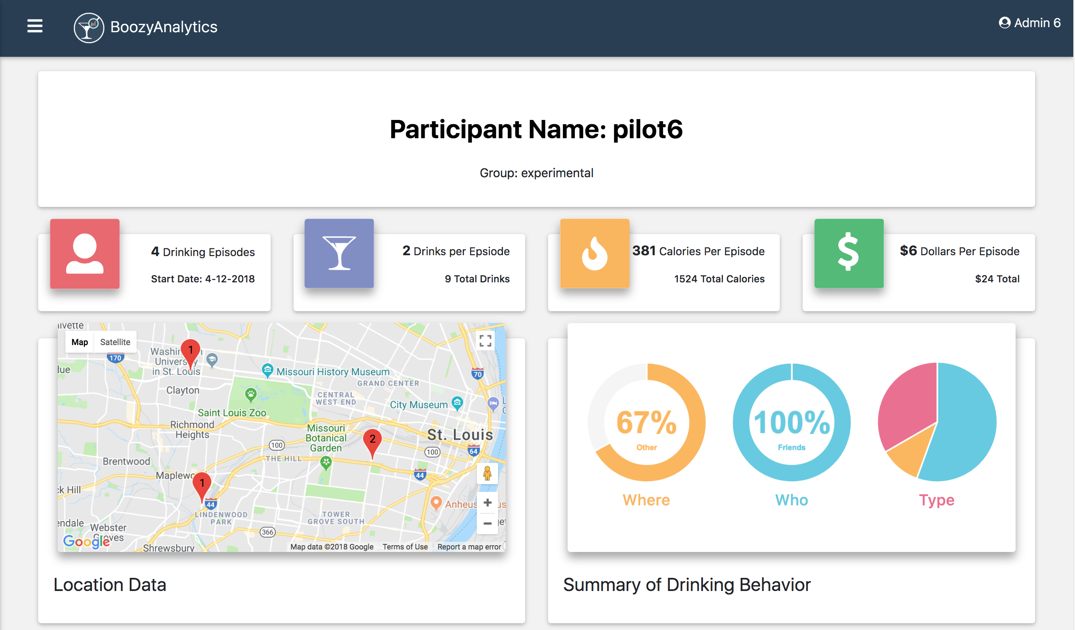
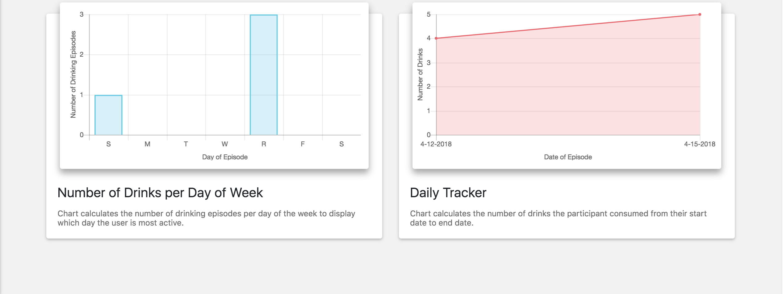

Slide 20
